Slide 1

AccuRadon FireHouse Crafts & Crusts Ballard: Big Slices/ Bold Brews

Slide 2
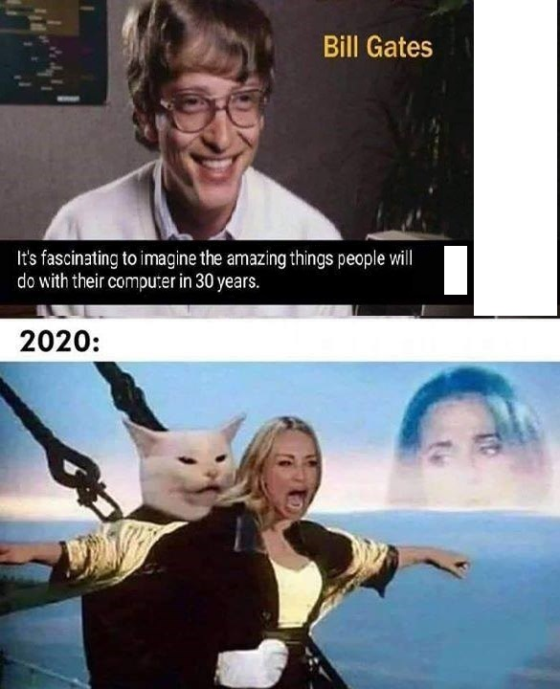
Measuring programming progress by lines of code is like measuring aircraft building progress by weight.
— Bill Gates

Slide 3
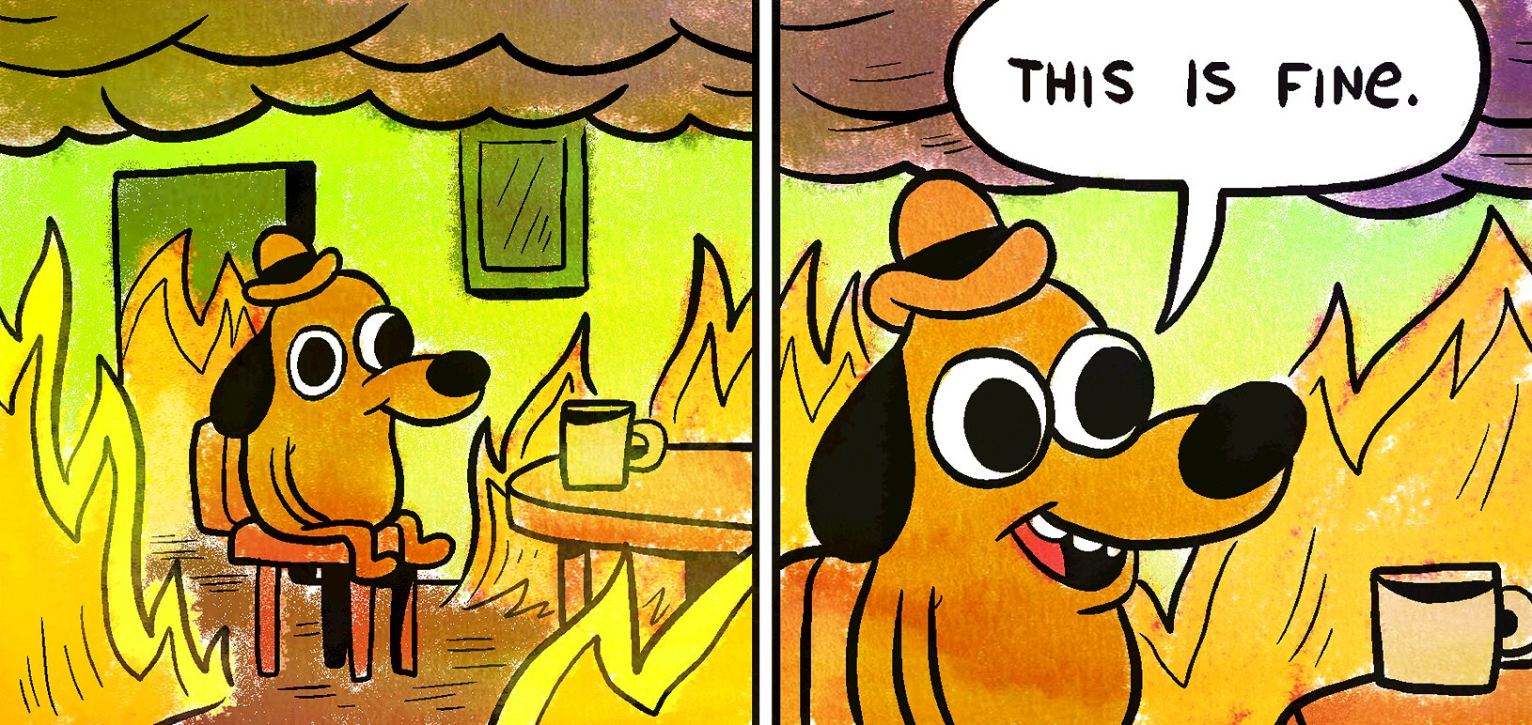

Slide 4


Slide 5
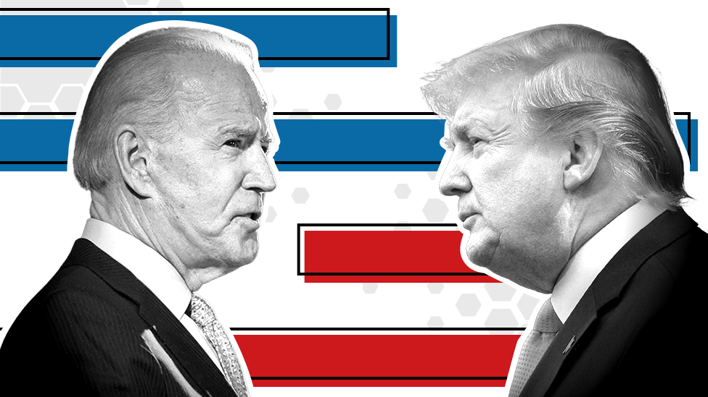

Slide 6


Slide 7
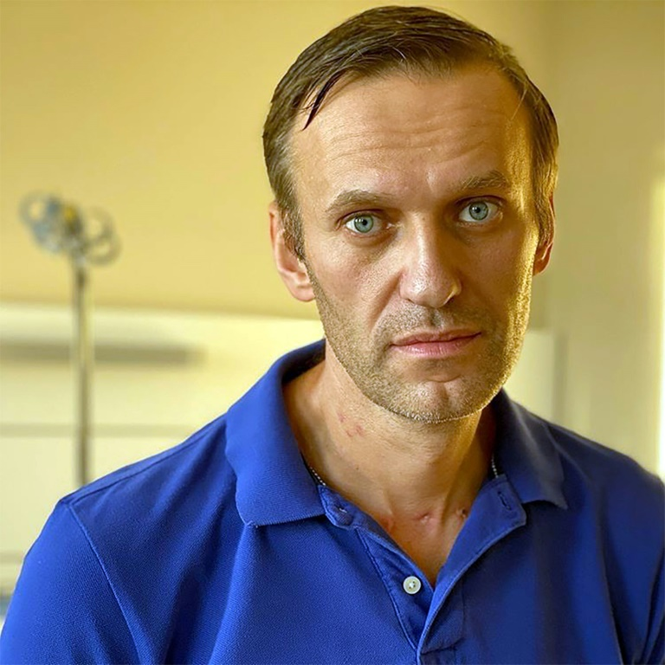

Slide 8


Slide 9

Introduction
1

Slide 10
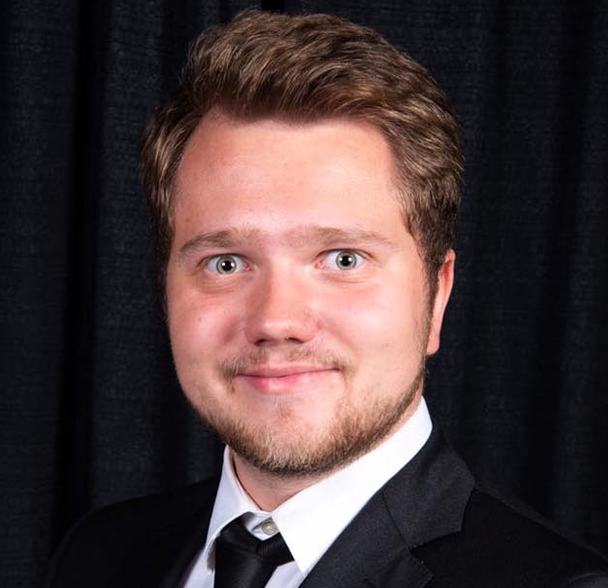
Hello!
I am Maksim Zubritckii
Major: Information Systems
Hobbies: Ballroom dancing, Music
Contact: maksimzubritckii@gmail.com

Slide 11
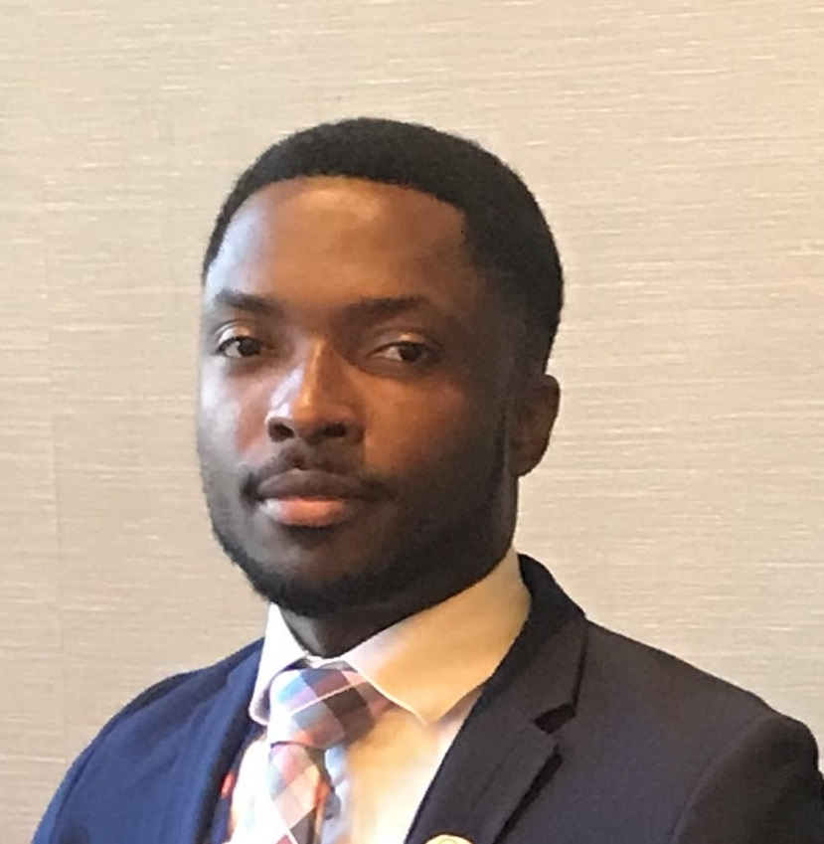
Hello!
I am Uriel Quartey
Major: Information systems
Hobbies: Basketball and swimming.
Contact: ukquart@ilstu.edu

Slide 12

Hello!
I am Tejas Mandalapu
Major: Iformation systems
Hobbies: kayaking, cricket, Badminton.
Contact: tcmanda@ilstu.edu

Slide 13
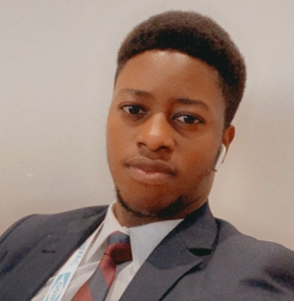
Hello!
I am Oluwatoba
Major: Information Systems
Hobbies: Hacking & Soccer
Contact: opadegb@ilstu.edu

Slide 14
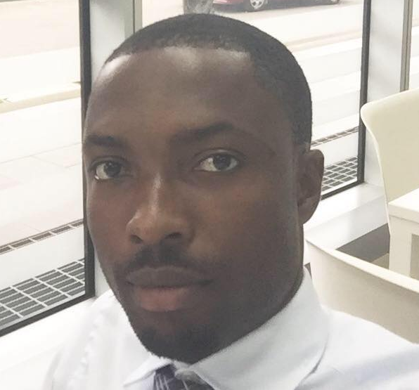
Maps
Normal Illinois

Slide 15

Project Roles:
Quality Assurance Engineer (QA) – Tejas Mandalapu
Requirement Analyst (RA) – Oluwatoba Adegbite
Project Manager (PM) – Maksim Zubritckii
Main Developer – Uriel Quartey

Slide 16
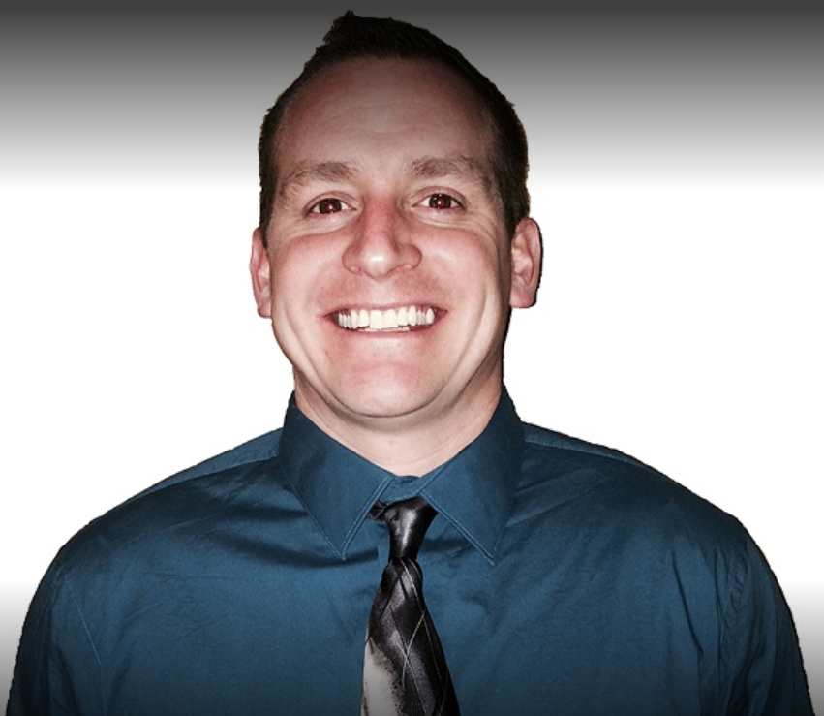
Client
I am John Cerda.
Owner of Ballards.
Operations Manager at Accuradon.

Slide 17
AccuRadon
2
The initial goal

Slide 18
Background Information
AccuRadon is a small business that essentially checks the radon levels that might be emitted out of the ground into American homes, which is the second leading cause of lung cancer in America.

Slide 19
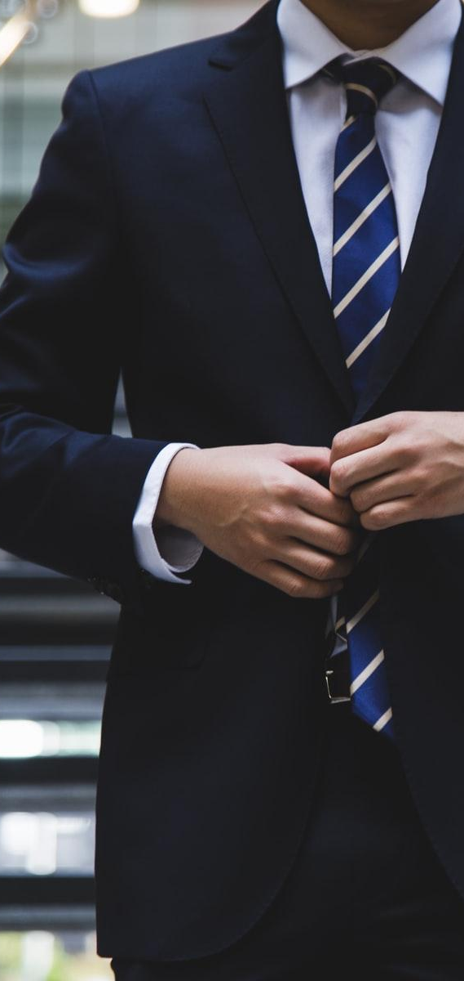
Business Requirements
Making appointments
Getting a quote for a test
Pay bills online
Geo-locator.
Enhance Security.

Slide 20
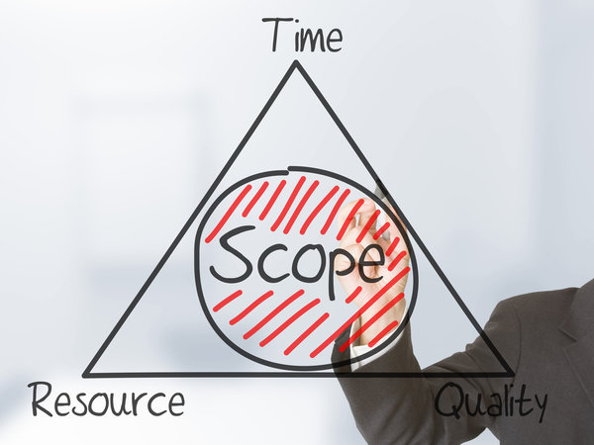
Scope of work
Accuradon
Website Overhaul
Increase Aesthetics
Social media integration.
Better web Flow.

Slide 21

Proposed Solution
Designed primarily around user needs and behaviors
A more user-friendly and usable site architecture and navigation
A clear strategy for how to develop and maintain website content on an on-going basis
A homepage that is intuitively designed around user-identified critical tasks
An instant quote which requires parameters like; location, number of rooms (what else)
A customer review section
Social media integration

Slide 22

Website Design Cost
Website Project | Web Design Costs
Domain Name | $12.00 for first year /$18 subsequent years
SSL Certificate | $100.00/year
Website Hosting | $35.00/year
Content Management System (CMS) | $200.00
Ecommerce Functionality | $1,000.00
SEO and Marketing | $150.00
Database Integration | $100.00
Annual Maintenance Fee | $600.00
Pages (1 - 50) | $2,000.00

Slide 23

$4,197.00
Total Website Design Cost

Slide 24

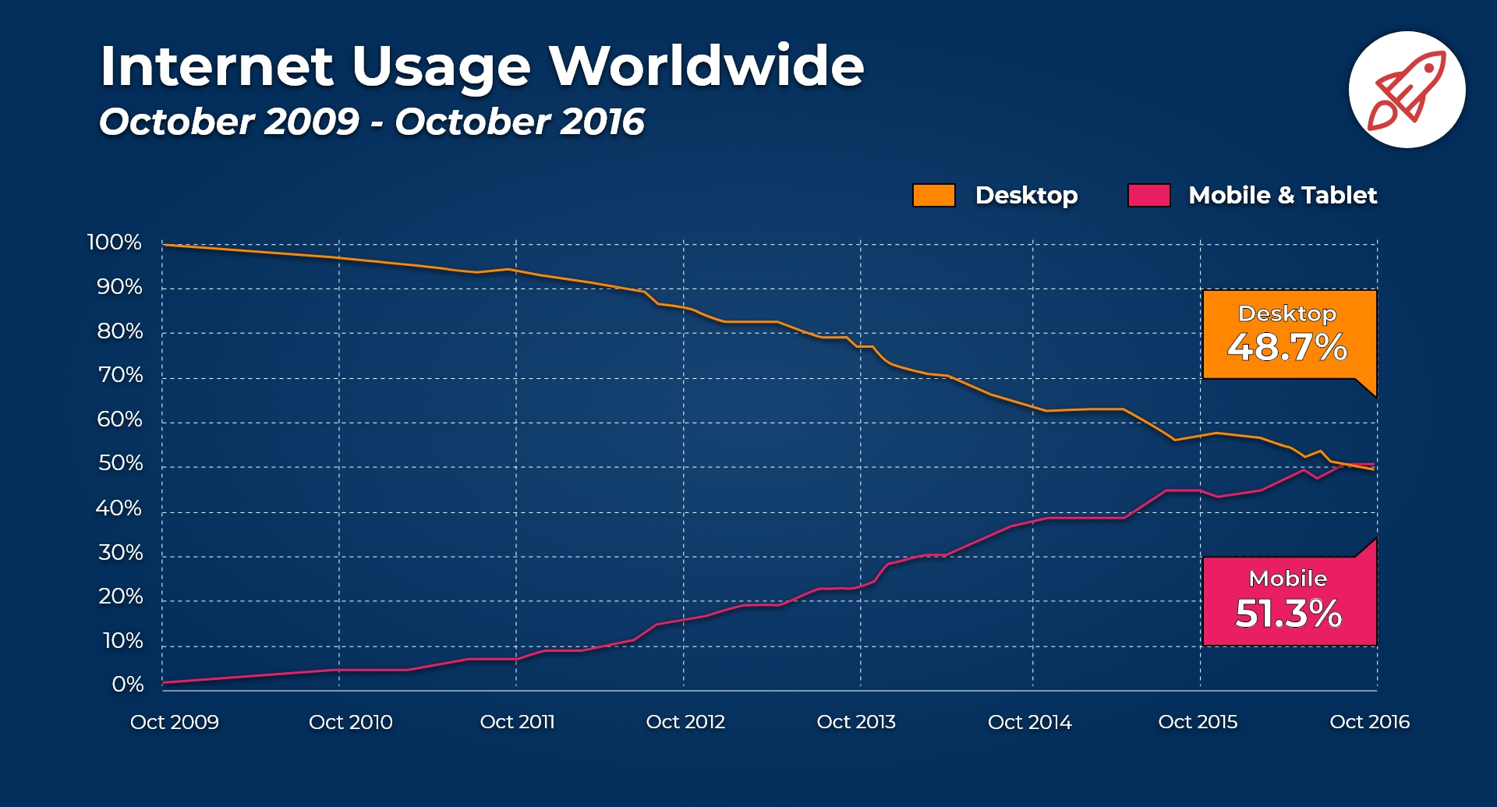
Mobile access

Slide 25
Google Web Designer
The website was originally built with Google Web Designer, so our team decided that the best way to proceed was to keep the old platform, explore it, and then redesign the page.

Slide 26
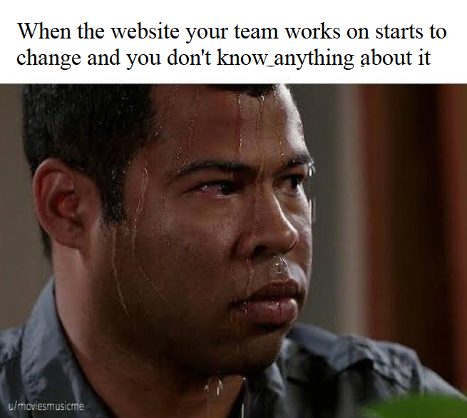

Slide 27
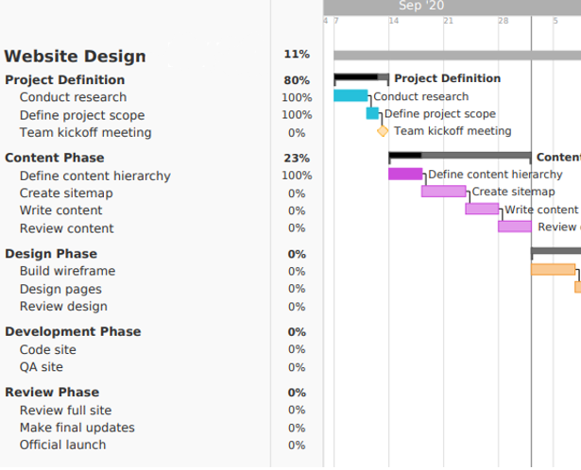
AccuRadon Website Design Gannt Chart
Project Sunk.

Slide 28


Slide 29
Big Switch
3
Project starts all over again

Slide 30
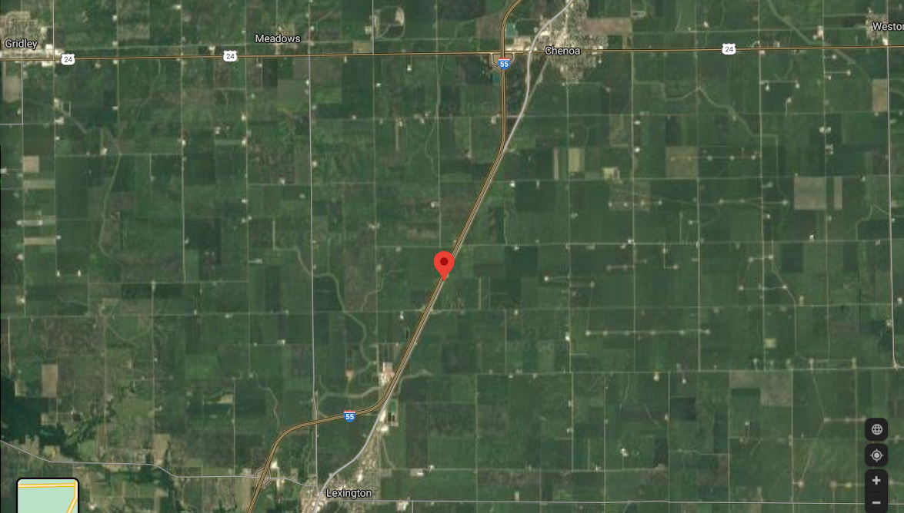
Ballard: Big Slices/Bold Brews
Town of Ballard
Town of Ballard Location 40°41'22.7"N 88°45'18.8"W

Slide 31
Business concept
An opportunity for a restaurant was recognized in an underutilized location.
The town of Chenoa is geographically located in a high traffic area, between Interstate 55, Route 24, and perhaps one of the most nostalgic roads in the country, Route 66.
Ballard is a town in between Chenoa and a neighboring town, Lexington.
Founder, Andrew Jolly grew up and farmed in the area that was once Ballard. A portion of the crops used to make our beer will be from the old Ballard Township.

Slide 32
Restaurant information
Pizza, Big Slices, Skillet Cookie, and guest chefs.
Our big slices will be something you don’t have to wait 30 min for. We want you eating (and drinking) in the first 5 min you arrive at our location.
20 tap options serving beer/cider/cocktail/wine/coffee

Slide 33
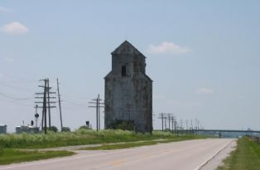
Contact Information
Email address: craftsandcrust@gmail.com
Physical address: 102 E Cemetery Ave St A
Phone number: (309) 532-3112
Facebook: www.facebook.com/groups/ballardslicesbrews/

Slide 34
Requirement Analysis
UNDERSTANDING THE CLIENT’S REQUIREMENTS
- USER STORY
- THE PURPOSE OF THE WEB APPLICATION
- THE TARGETED AUDIENCE
DRAFTING A BUSINESS REQUIREMENT DOCUMENT (BRD)
PLANNING
- Wireframing
- Sitemap
SELECTING THE TECHNICAL STACK
- CHOOSING THE FOUNDATION FOR THE WEBSITE
- CHOOSING THE PROGRAMMING LANGUAGE
- ADDITIONAL SERVICES
MILESTONE BIFURCATION
DECIDING ON RESOURCES AND ESTIM

Slide 35
Project Sunk consequences​
Finals
1
Second Half of the semester- FireHouse Crafts & Crusts Ballard: Big Slices / Bold Brews
2
First Half of the semester - AccuRadon
.
3

Slide 36

“Just try new things. Don’t be afraid. Step out of your comfort zones and soar, all right?” – Michelle Obama

Slide 37
Development
4
Finally developing the product

Slide 38
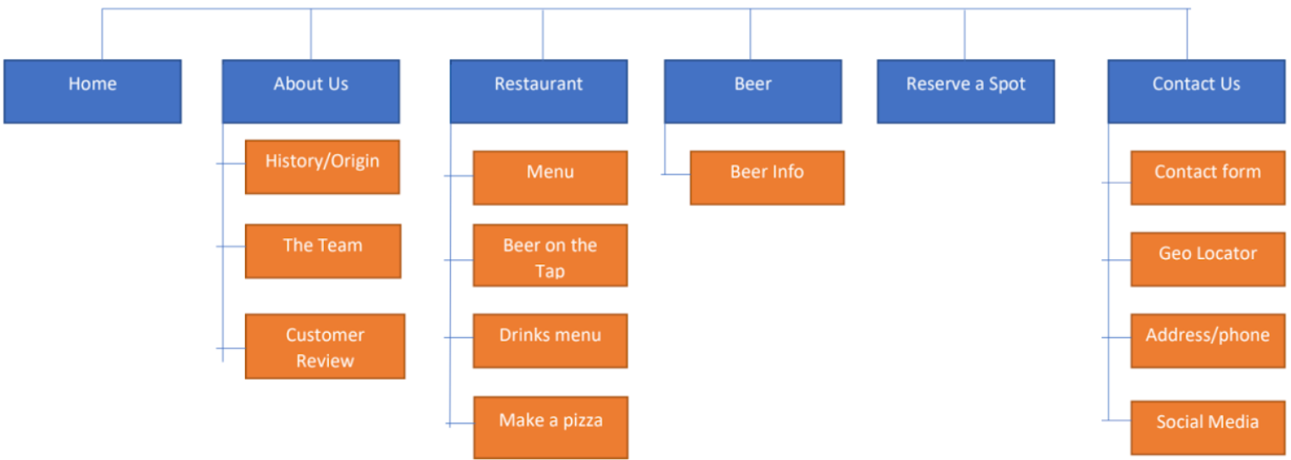
Website Map

Slide 39
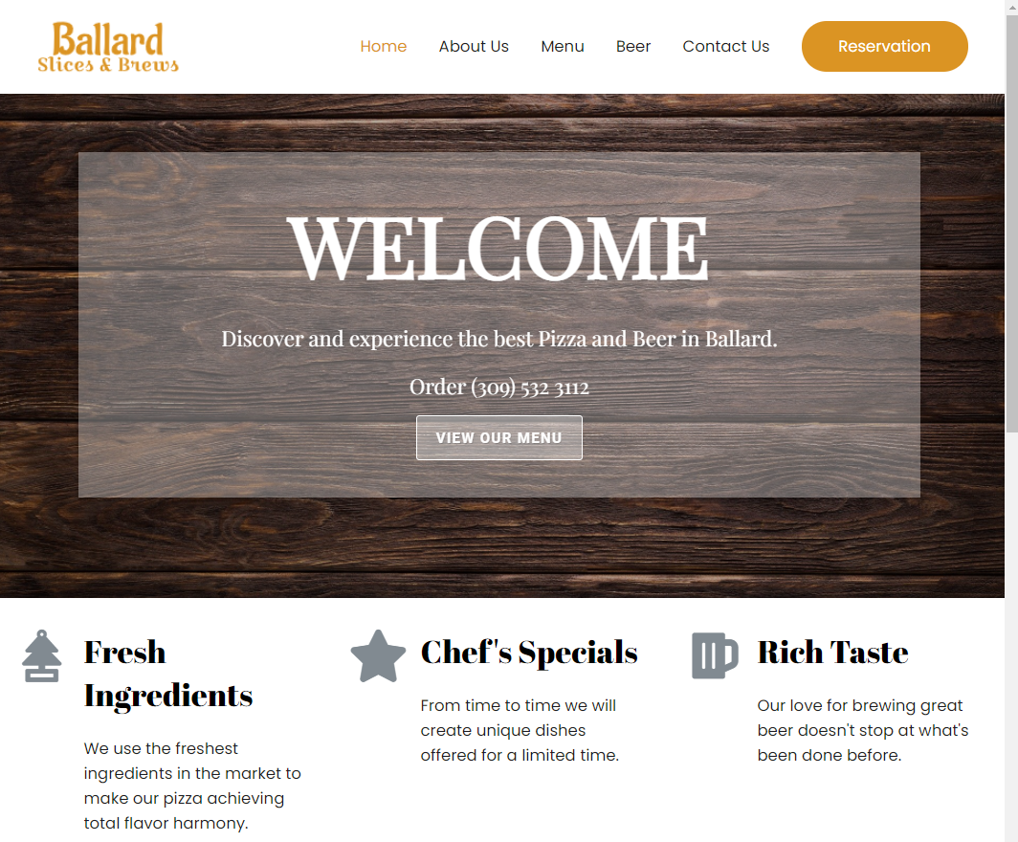
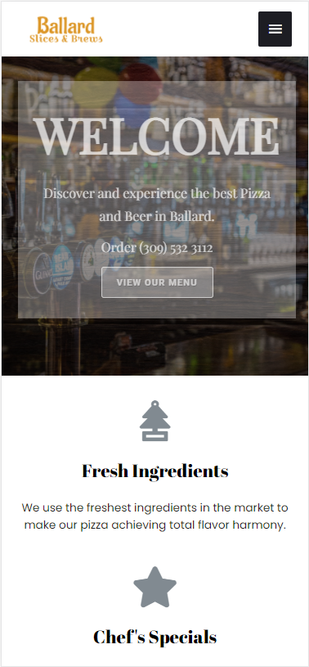
New Look

Slide 40
Thanks!
Any questions?

